Slide 1
Prediction of Agriculture Crop Production in India
Prepared by: Alladi Prempaul
Internship: upskill Campus & The IoT Academy
Industrial Partner: UniConverge Technologies Pvt Ltd (UCT)

Slide 2
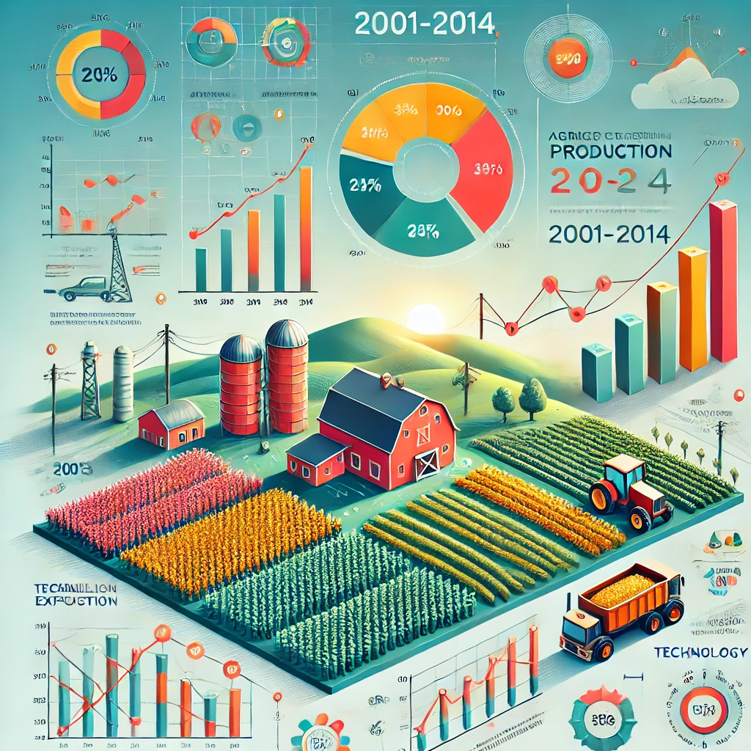
Introduction
Focus on predicting agricultural crop production
Analyzed data from 2001-2014
Real-world industrial exposure

Slide 3
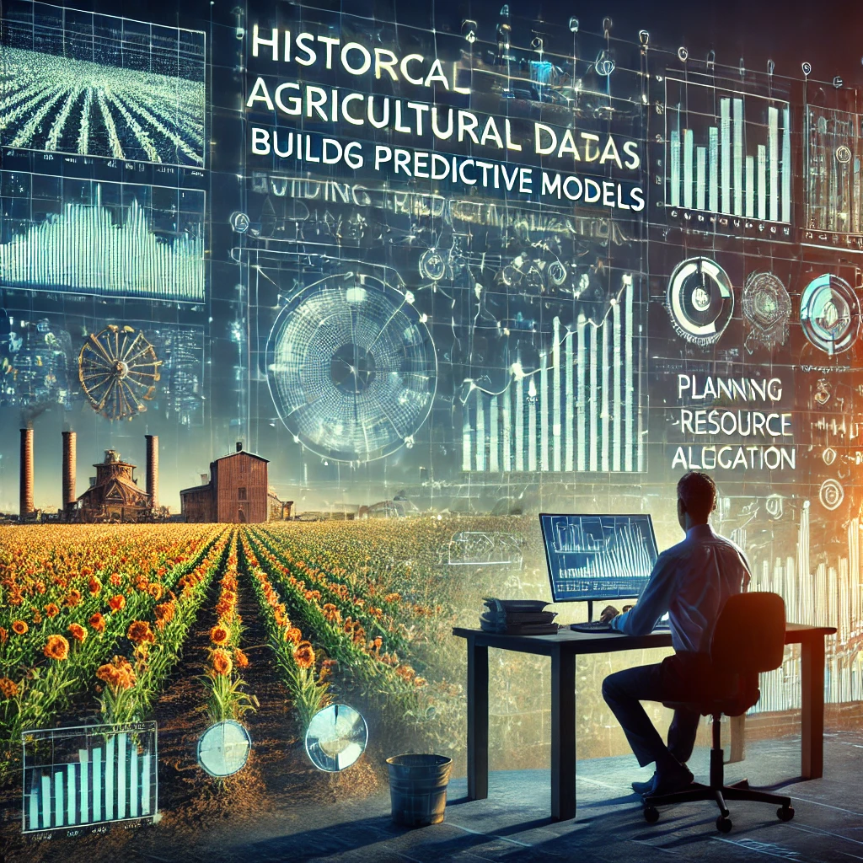
Objectives
Analyze historical agricultural data
Build predictive models
Aid planning & resource allocation
Enhance technical skills

Slide 4
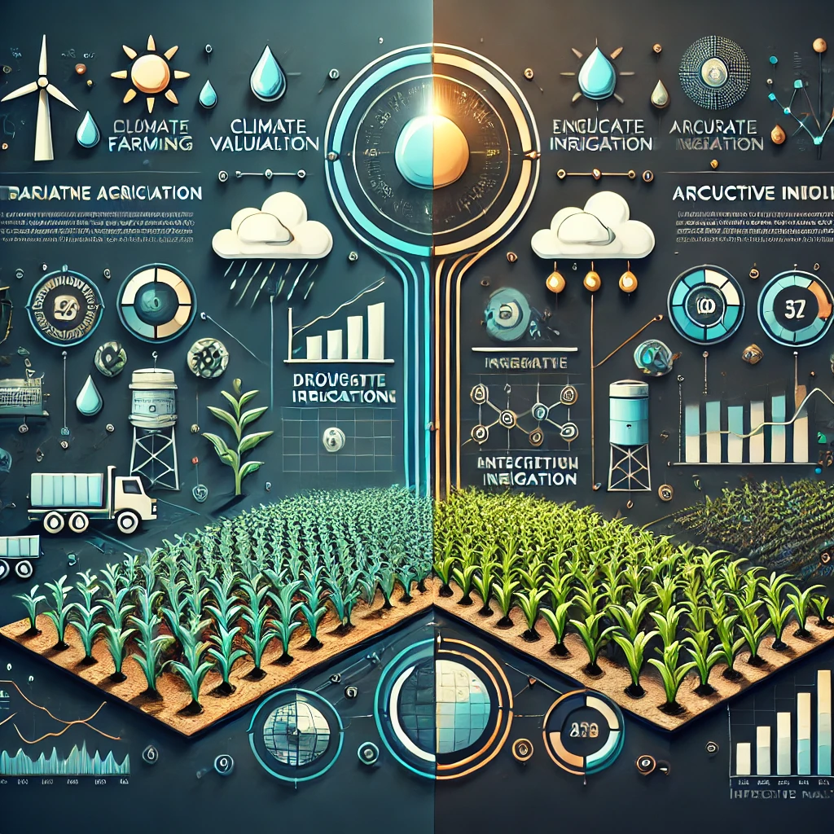
Problem Statement
Challenges: Climate variability, resource limits, inefficient practices
Need for accurate crop forecasts
Data-driven decision-making

Slide 5
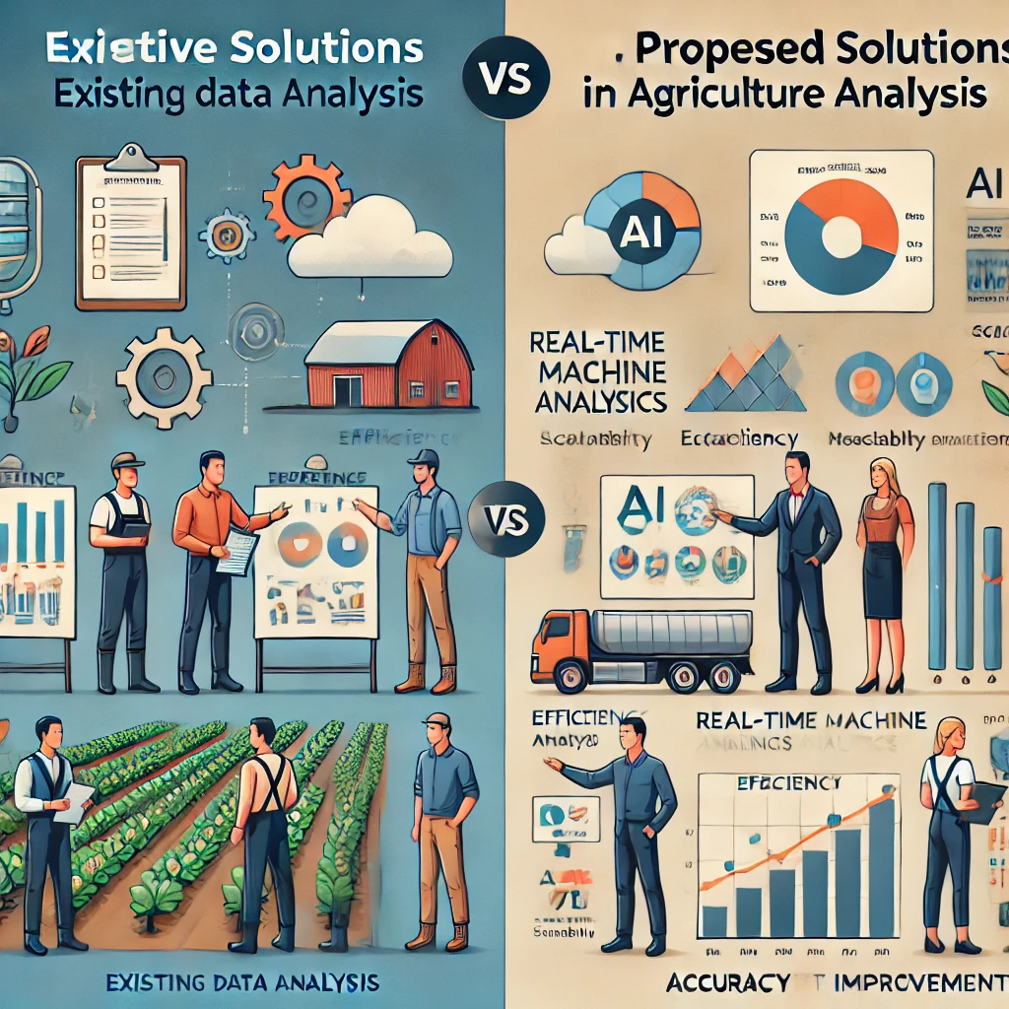
Existing vs Proposed Solution
Existing: Manual data analysis, expert opinions
Proposed: Machine learning models (accuracy, efficiency, scalability)

Slide 6
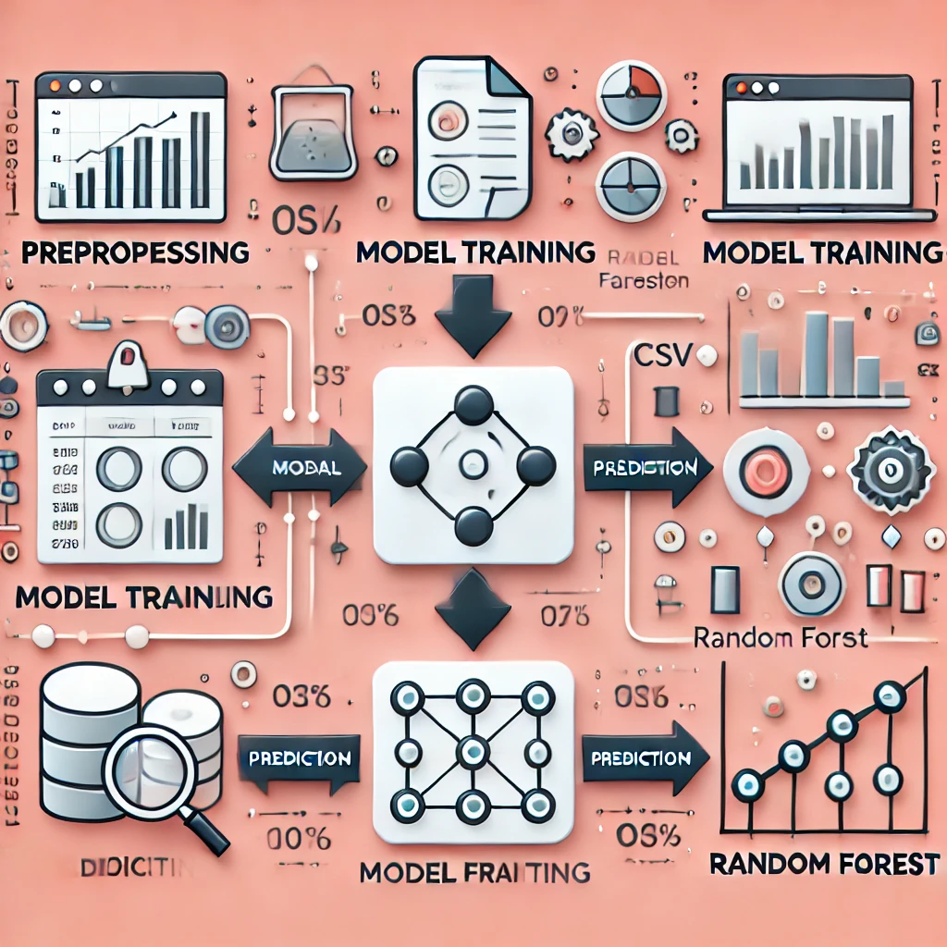
Proposed Model
Data Source: CSV from data.gov.in
Algorithms: Linear Regression, Random Forest
Process: Preprocessing → Model Training → Prediction

Slide 7
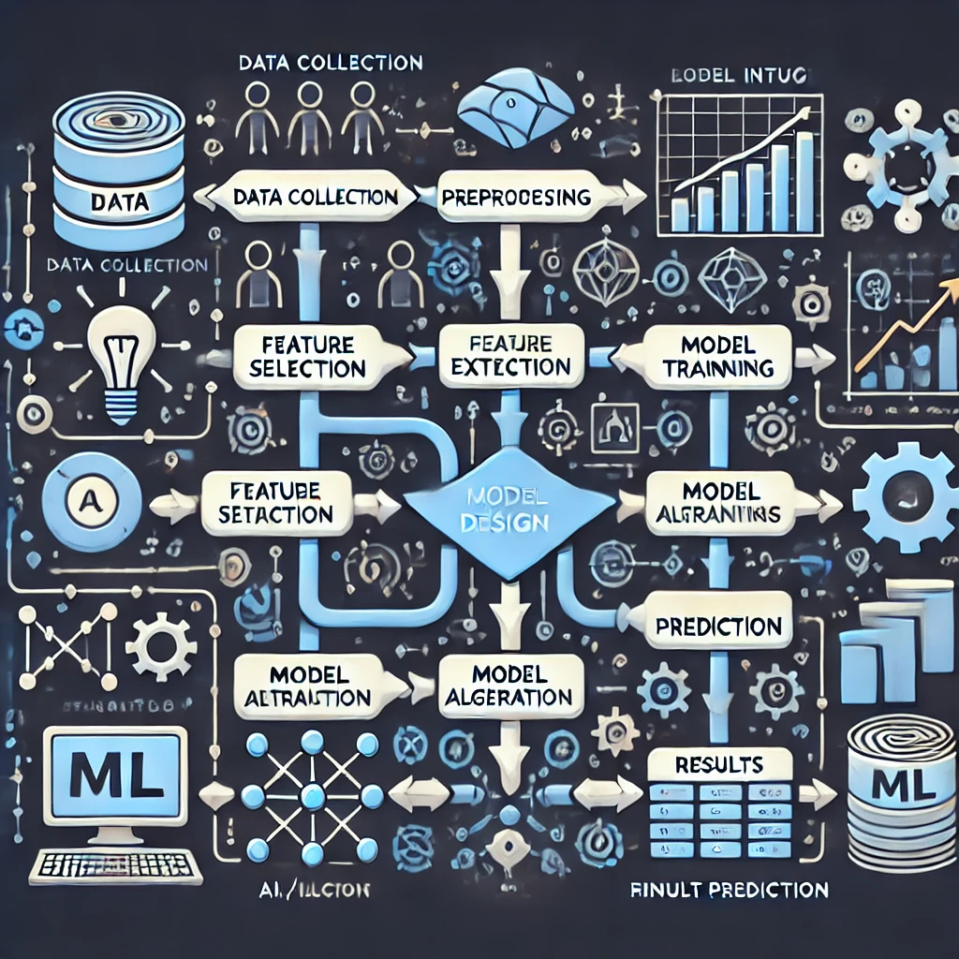
Data Flow & Model Design
High-Level: Data collection, preprocessing, model training, prediction
Low-Level: Data input, feature selection, ML algorithms, results

Slide 8
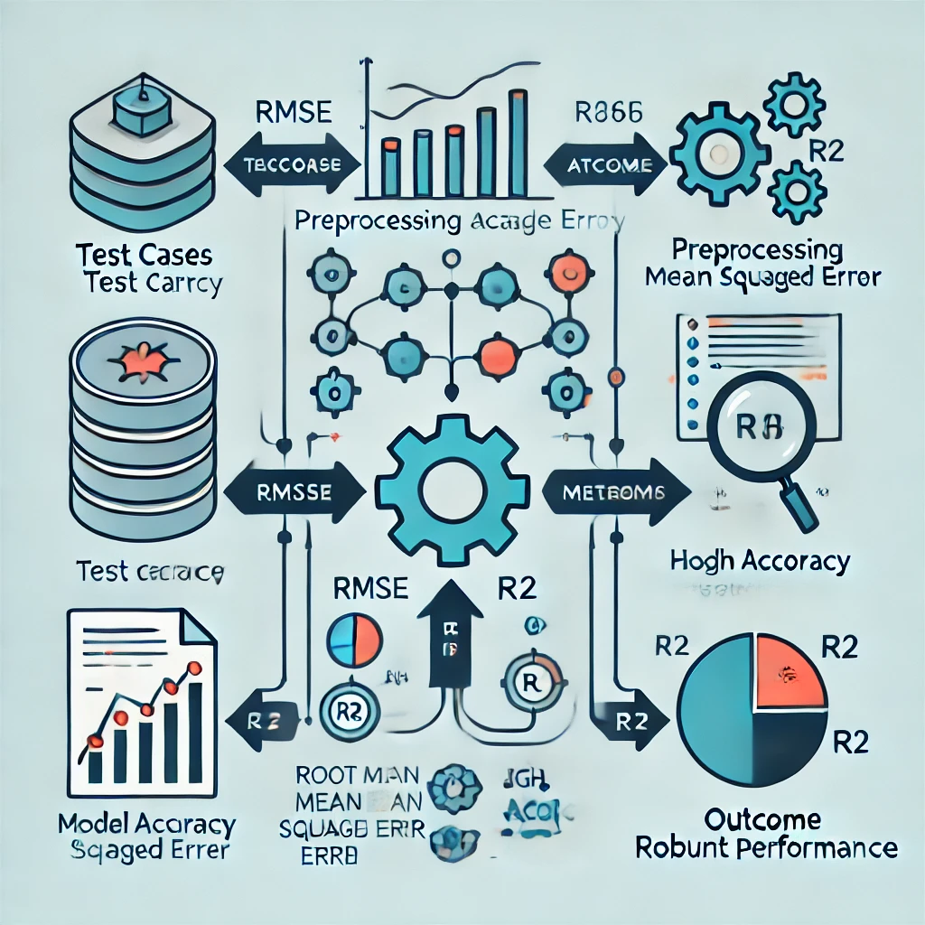
Performance Evaluation
Test Cases: Preprocessing accuracy, model validation
Metrics: RMSE, R²
Outcome: High accuracy, robust performance

Slide 9
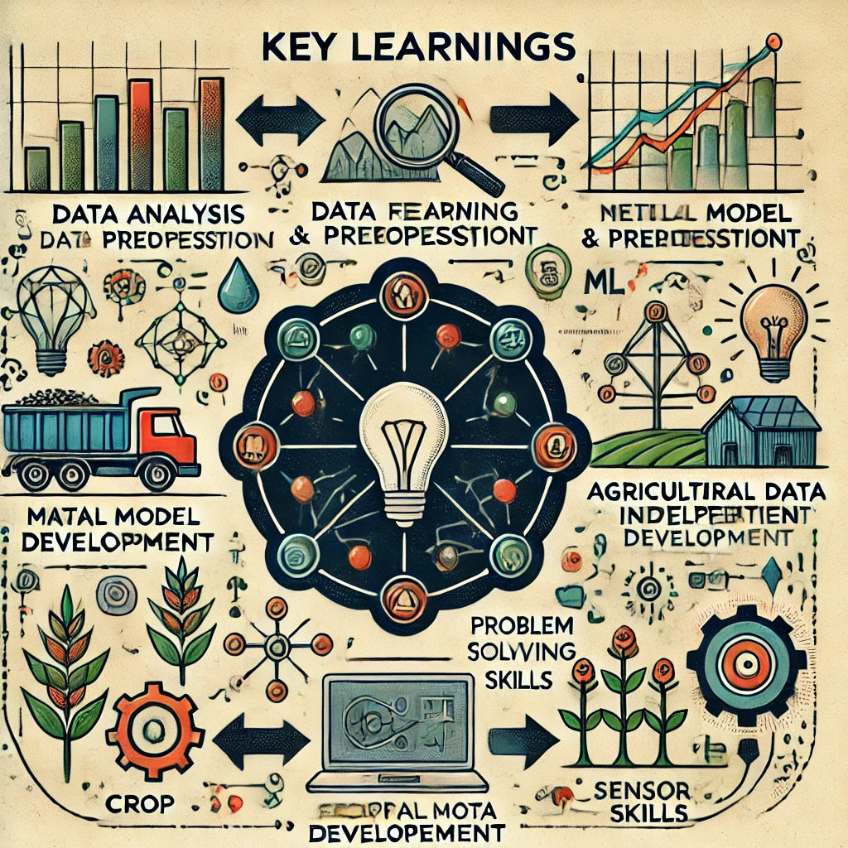
Learnings from PROJECT
Data analysis & preprocessing
ML model development
Agricultural data interpretation
Problem-solving skills

Slide 10
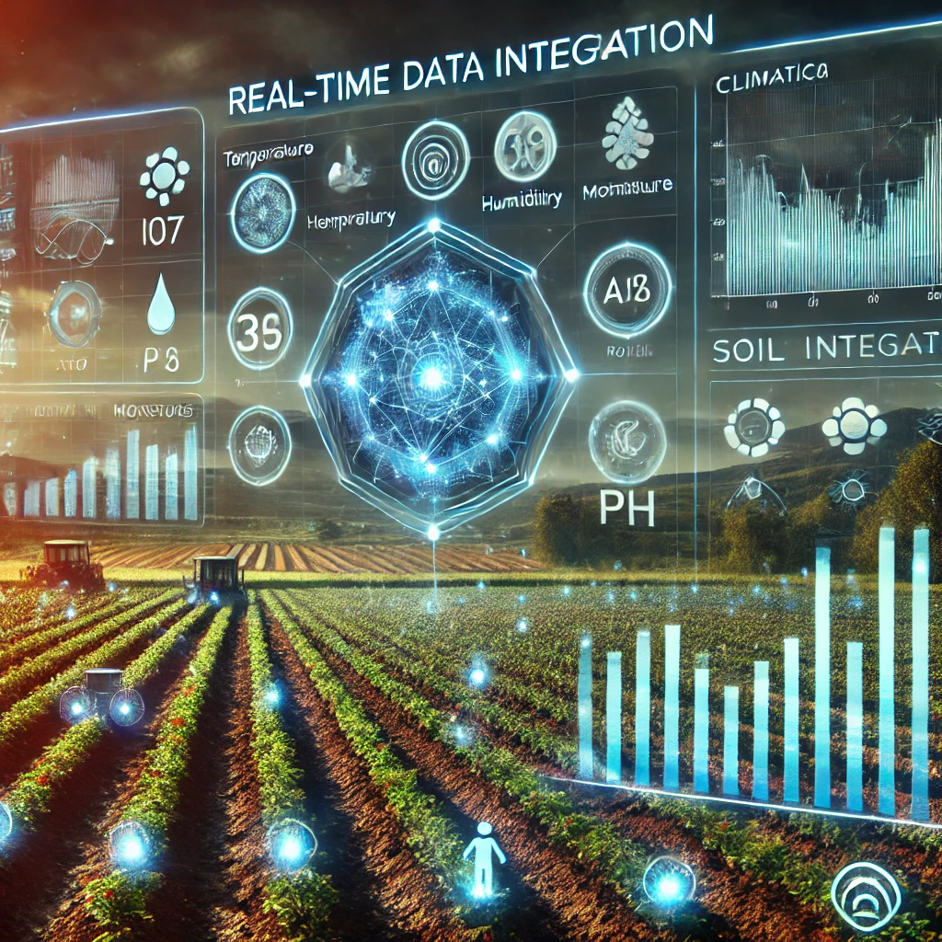
Future Scope
Real-time data integration
Include climatic & soil parameters
Develop dashboards for stakeholders

Slide 11


